Slide 1
Thriller
By Kaleb Ryan, Daniel Ford, and Maddie Cinelli

Slide 2
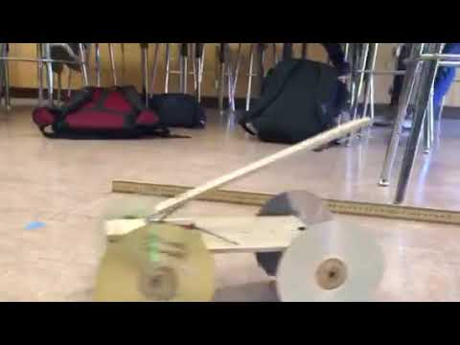

Slide 3
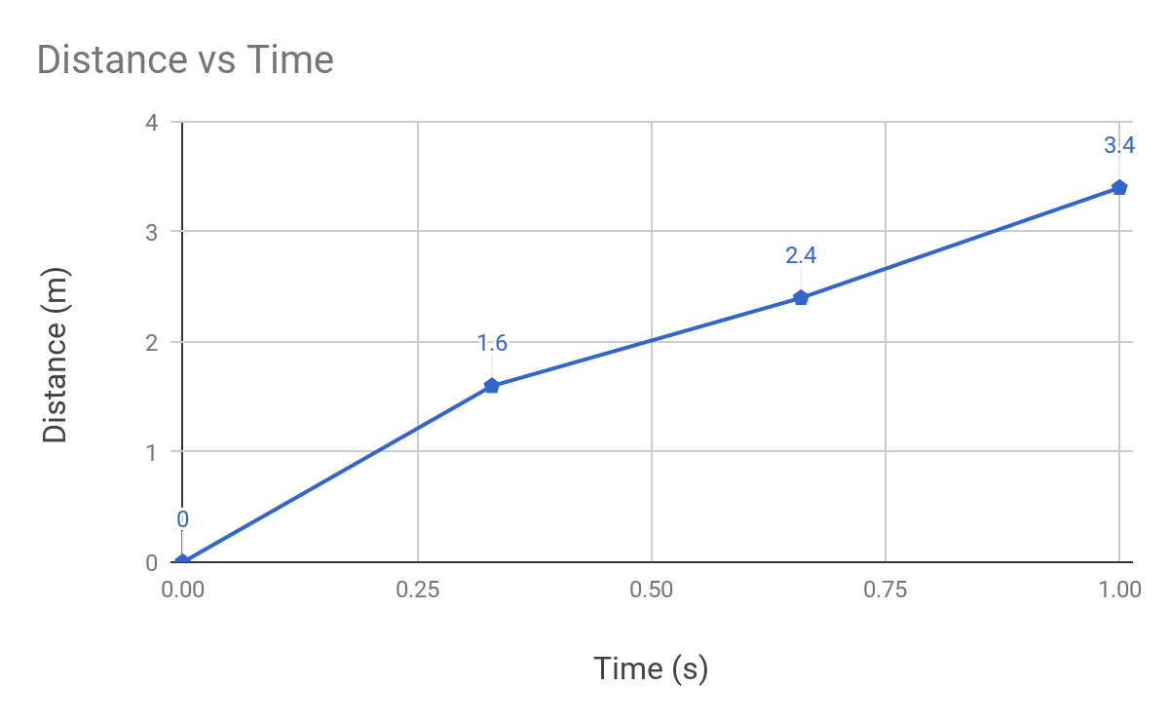
Distance vs Time

Slide 4
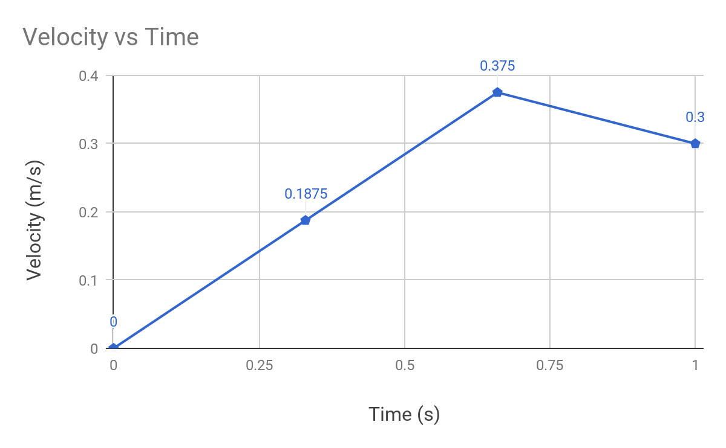
Velocity vs Time

Slide 5
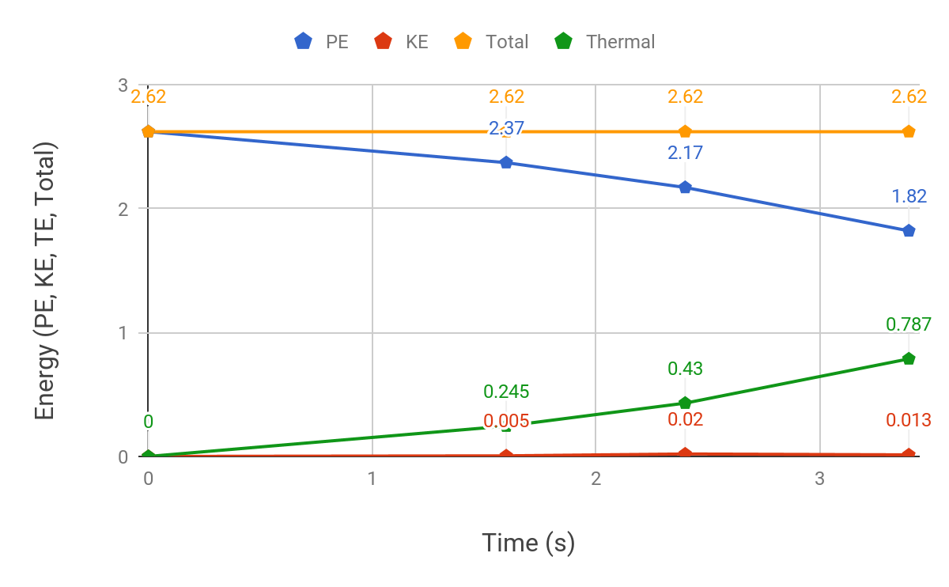
Energy vs Time

Slide 6
Friction
On Axles: attached a smaller block to put the axles through to minimize surface area of contact
On Wheels: very low friction on the wheels - we did not add any tire such as duct tape or rubber bands in order to keep the circular shape of the wheels so it would roll easier.

Slide 7
Selling Points
Very little energy input - simply pull back the mousetrap
Low mass/weight - portable
Low cost
Includes Michael Jackson’s Thriller CD as a wheel

Slide 8
Reflection
The axles were too loosely attached to the frame of the car which made the axles tilt.
We didn’t have our strings attached evenly so one side of the axle would be pulled more, causing the wheels to rub against the frame of the car.
The string would produce a lot of friction and may even get tangled up.
All of the friction would prevent the car from moving, so it would stop before the mousetrap had the chance to fully snap down. We still had potential energy left over at the end, but it was prevented from turning into kinetic energy.

